Slide 1

INSY 8311 & Database Development
StockWise
Multi-Branch Retail Inventory & Automated Reorder System
Student: Rugira Gyslain (20251IMA019)
Instructor: Eric Maniraguha
github.com/gyslainrugira/rugira_25964_stockWise

Slide 2
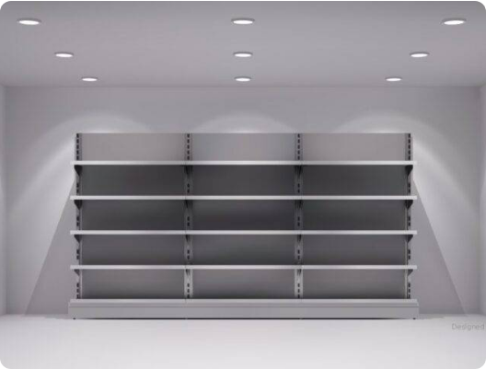
The Supply Chain Gap
•
Sector Reality: 87% informal trade reliant on manual tracking.
•
Lost Potential: 50.9% capacity underutilization from bottlenecks.
•
Stockout Cost: Immediate revenue loss during peak demand.
•
Capital Drain: Overstocking slow-moving items ties up funds.

Slide 3

Replacing static sheets with active databases.
Embedding deterministic inventory control directly into the server kernel to eliminate human error and procurement delays.

Slide 4
Project Objectives
Main: Automate stock replenishment via Oracle PDB.
3NF Normalization
Algorithmic Reorder
Transforming flat sales into strict relational entities.
PL/SQL triggers tracking dynamic safety stock thresholds.
ACID Compliance
Live Dashboard
Custom exceptions blocking out-of-stock transactions.
Power BI visualizing pending requisitions instantly.

Slide 5
System Comparisons
Standard Retail ERPs
StockWise Architecture
•
External business logic layers.
Database-Native Logic: Rules embedded in PL/SQL.
•
•
High latency in data synchronization.
•
Zero Latency: Triggers execute instantly on insert.
•
Complex, expensive infrastructure.
•
Cost-Effective: Core engine handles all processing.

Slide 6
Real Transactional Data
541,909
Raw records from UCI Repository
InvoiceNo | StockCode | Quantity | UnitPrice | CustomerID
536365 | 85123A | 6 | 2.55 | 17850
536365 | 71053 | 6 | 3.39 | 17850
536366 | 22633 | 2 | 1.85 | 17850

Slide 7
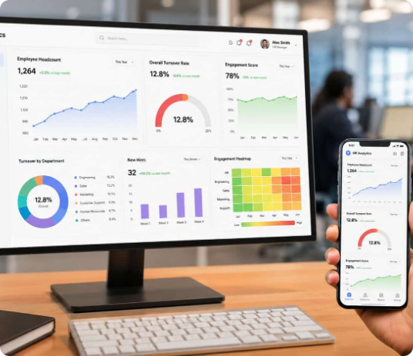

Solution & Innovation
Oracle Pluggable Database
Centralized transactional repository.
Autonomous Replenishment
Triggers generate instant purchase requests.
Interactive Analytics Layer
Power BI dashboard tracking capital turnover.

Slide 8

Schema Design (3NF)
CUSTOMERS
ORDERS
REORDER_REQUESTS
SUPPLIERS
ORDER_ITEMS
AUDIT_LOG
PRODUCTS

Slide 9
PL/SQL Architecture
Autonomous Triggers
Explicit Cursors & Audit
Packages & Functions
TRG_CHECK_REORDER_LEVEL: Automatically inserts a purchase request into REORDER_REQUESTS when stock drops below minimum safety thresholds.
INVENTORY_MGMT_PKG: Groups sale processing procedures using FORALL bulk inserts for fast checkout execution.
c_pending_reorders: Fetches all unapproved purchase requests to process batch vendor orders.
FN_CALCULATE_REORDER_POINT: Evaluates 30-day sales history to compute safety stock levels.
TRG_BEFORE_ORDER_ITEM: Blocks the checkout of any item that exceeds available inventory.
TRG_AUDIT_STOCK_CHANGE: Logs stock adjustments, user IDs, and timestamps into INVENTORY_AUDIT_LOG.

Slide 10
Expected Outcomes
0%
100%
24/7
Out-of-stock events.
Transaction integrity.
Live inventory visibility.

Slide 11
Future Roadmap
1
Machine Learning Integration
Dynamic demand forecasting via Oracle ML.
2
Supplier Portal API
Direct external vendor purchase synchronization.

Slide 12
References
•
Dania, A., & Adediran, A. (2025). Genetic Algorithm Optimization for Inventory Control. Pesquisa Operacional.
•
Mishra, A., & Mohapatra, M. (2026). POSventory: Integrated Inventory Management. IJSIE.
•
National Institute of Statistics of Rwanda (NISR). (2024). Integrated Business Enterprise Survey.
•
Oracle Corporation. (2026). Oracle Database PL/SQL Language Reference, 19c.
•
UCI Machine Learning Repository. (2015). Online Retail Transactional Dataset.

Slide 13




Image Sources
https://img.magnific.com/premium-photo/bright-modern-warehouse-interior-with-shelves-clean-floor-space_908344-187672.jpg?semt=ais_hybrid&w=740&q=80
Source: www.magnific.com
https://www.slimstock.com/wp-content/uploads/2025/03/the-hidden-cost-os-stock-outs.jpg
Source: www.slimstock.com
https://www.finaleinventory.com/wp-content/uploads/2025/08/inventory-turnover-ratio.jpg
Source: www.finaleinventory.com
https://www.hubengage.com/wp-content/uploads/2026/07/hr-analytics-dashboard-data-visualization.jpg
Source: www.hubengage.com

